Slide 1
Solar panel project. -Power device
By-Ramin Kurkeice

Slide 2
Introduction
Proposal:

Slide 3
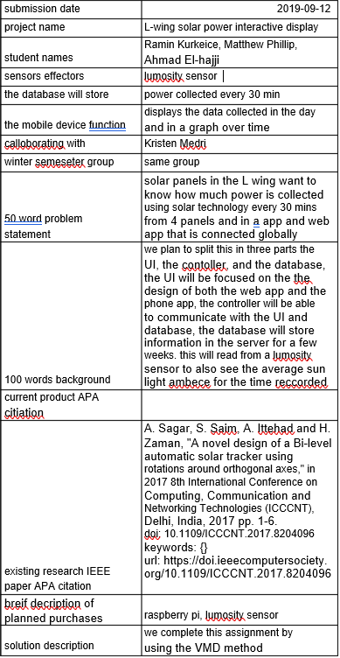
What has changed?
Added sensors, zmpt101b-voltage, ACS712-Current,OSEPP LM35- temp sensor.
Collaborators was actually Kerry Johnston, but we were unable to make contact so we got in touch with Dragos Paraschiv.
Focusing on the hardware components of this project.

Slide 4
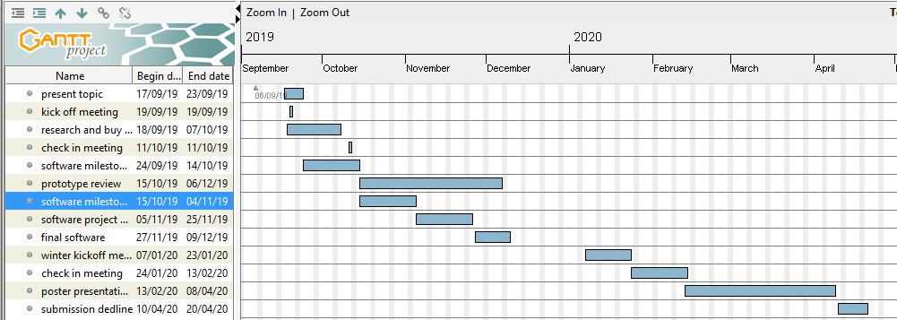
Schedule followed?
delayed 2 week.

Slide 5
Budget

Slide 6
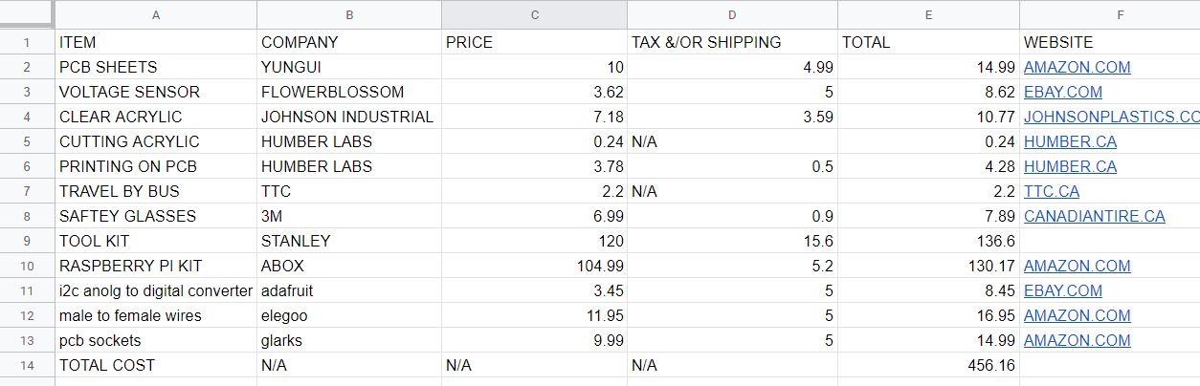
What was added?
I2c analog to digital converter
Male to female wires
Pcbsockets
Total cost rose from $415 to $456 in total value of this project.

Slide 7
Enclosed hardware

Slide 8
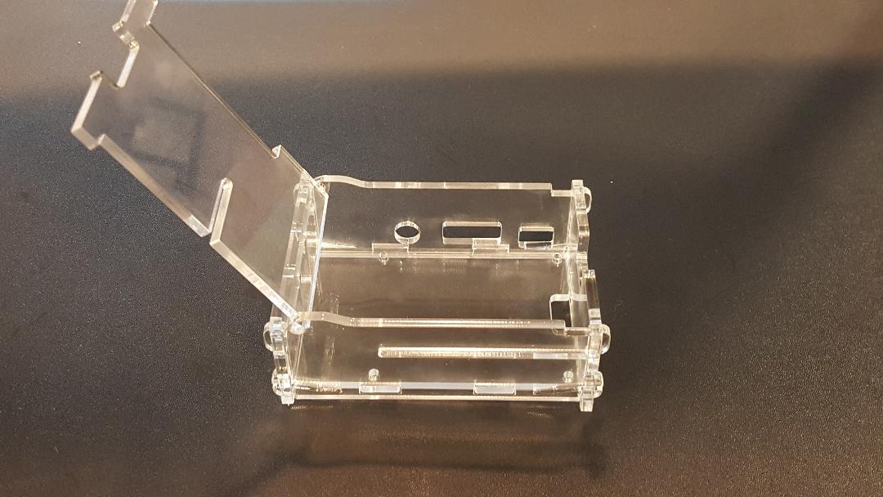

Slide 9
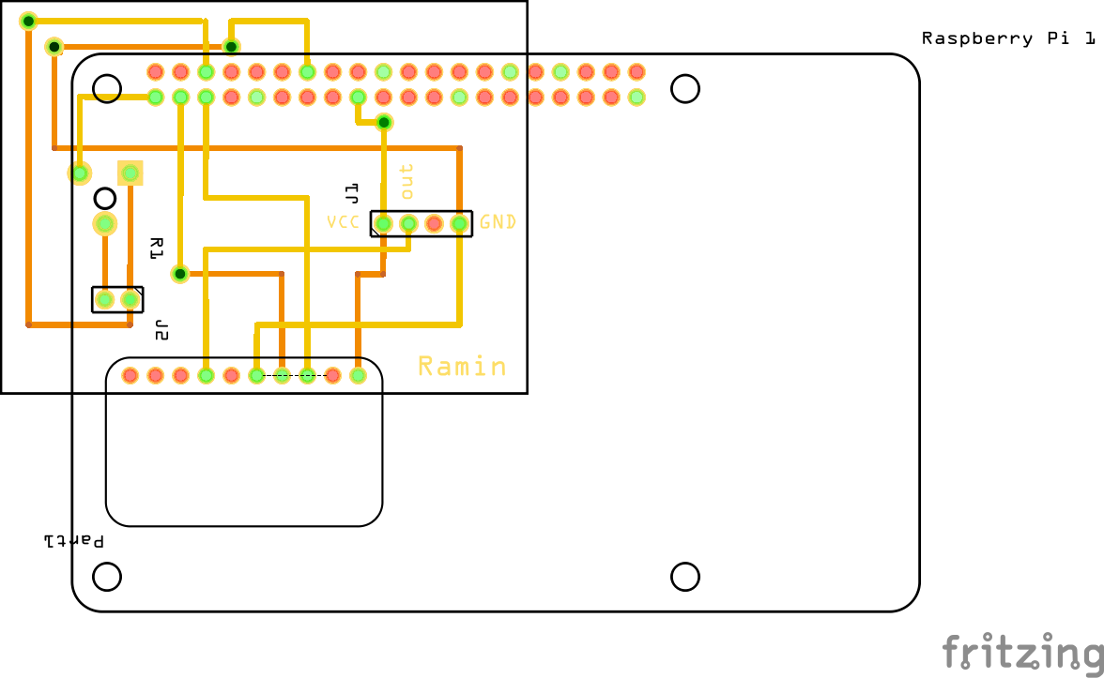
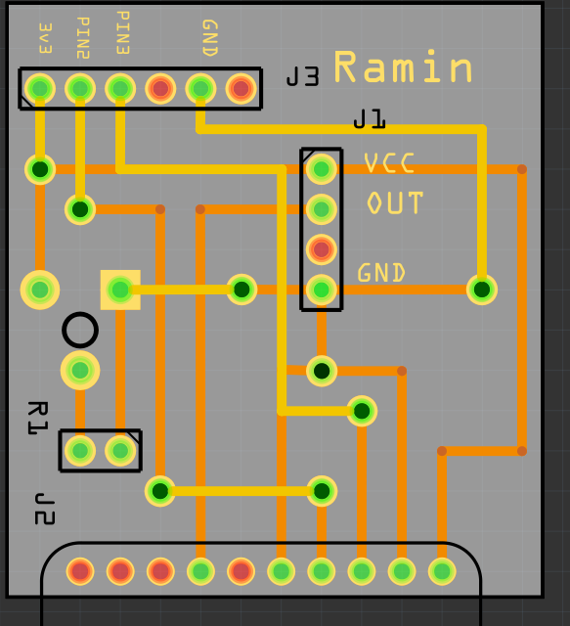

Slide 10
Knowledge

Slide 11
Knowledge
Knowledge acquired excluding in class material learned.
Unix courses (command line)
TECH 101 and 150 (wiring and soldering)
Thingiverse (based my blueprints off)
Google (general questions)

